Slide 1
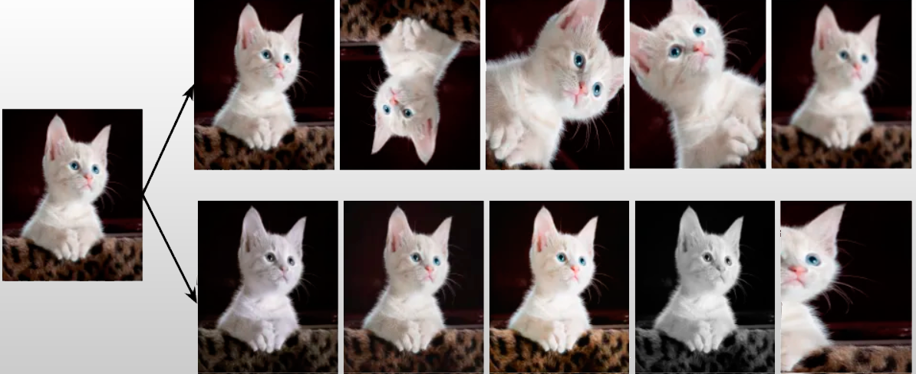
Data Augmentation in Neural Networks
In application for images and time series

Slide 2
Table of Content
Introduction
Data Augmentation for images
Data Augmentation for timeseries
Conclusion

Slide 3
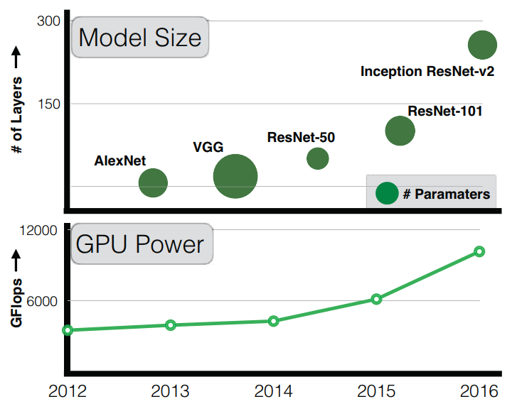
Neuronal Networks
Introduction
Requirements
Dataset
Model
Hardware
[1]

Slide 4
Dataset Problems
Introduction
Data quality
Correct labeling
Balance
Completeness
…
Data quantity
[1,2]
Notes:
* Computational learning theory

Slide 5
Data Augmentation
Introduction
Expand dataset through synthetic data
Increase generalization ability of the trained model
Reducing overfitting
Expanding the decision boundary of the model
[2]

Slide 6
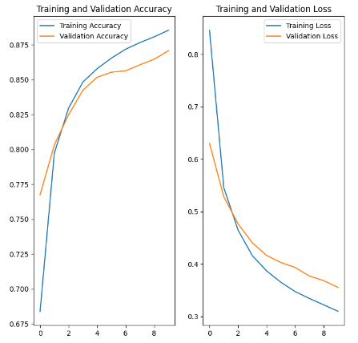
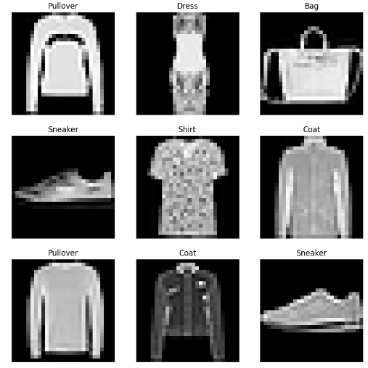
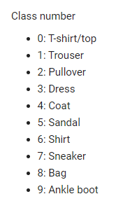
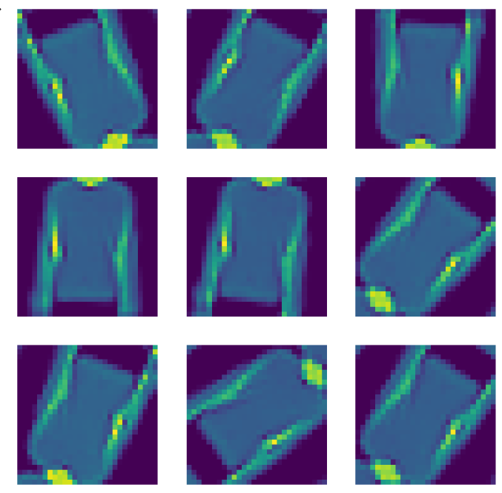

Data Augmentation for images
Fashion MNIST
-from Tensorflow
80% of the data used for training
Using Keras for preproducing layer
[3], [4], [5], [6]

Slide 7
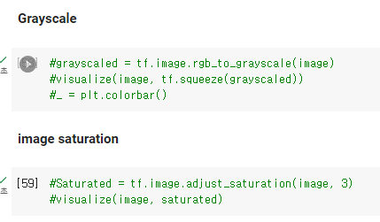
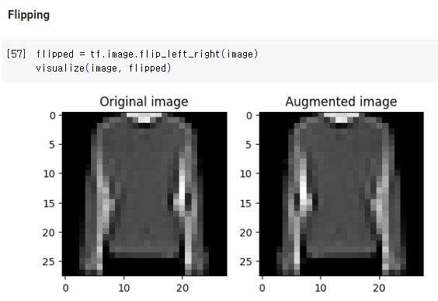
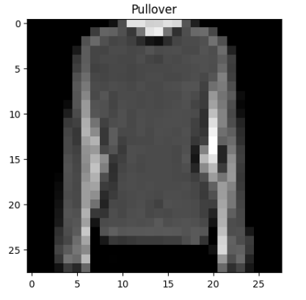
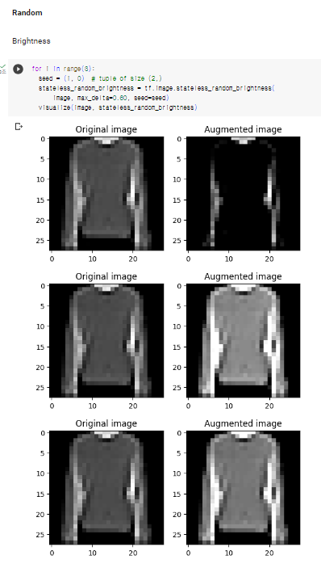
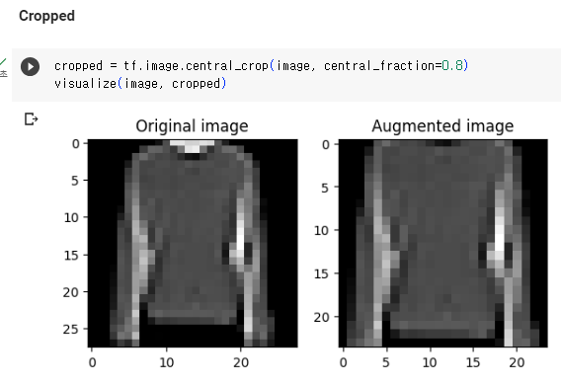
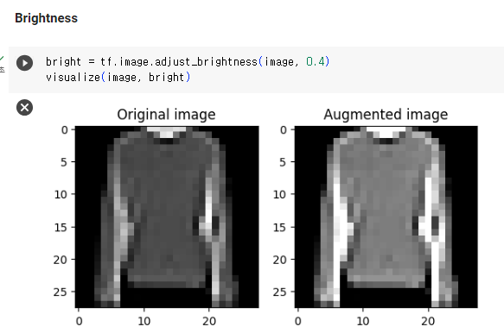
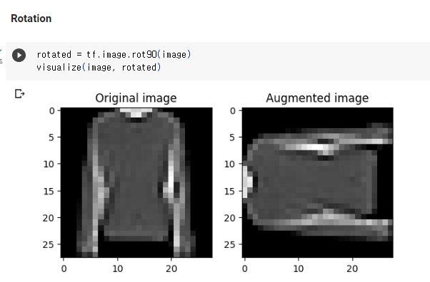
Data Augmentation for images
Examples with tf.images
[3], [5]

Slide 8
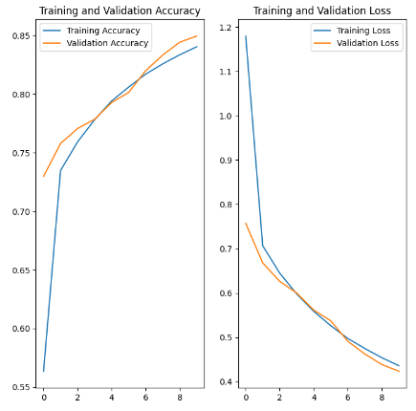
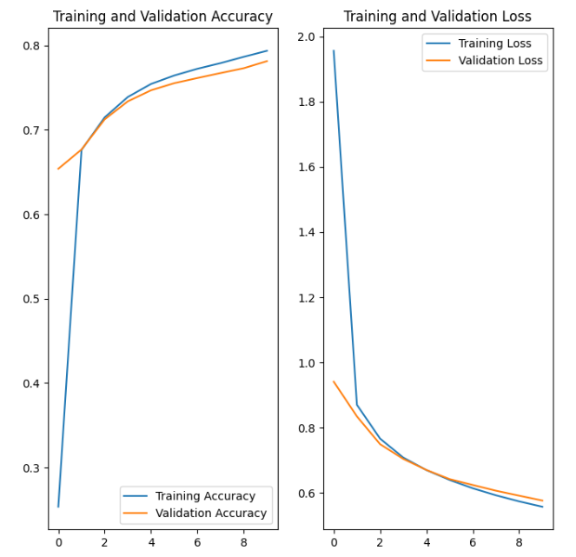
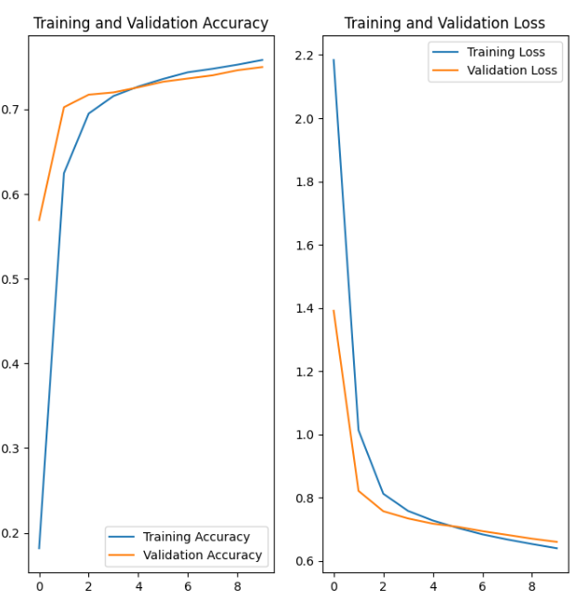
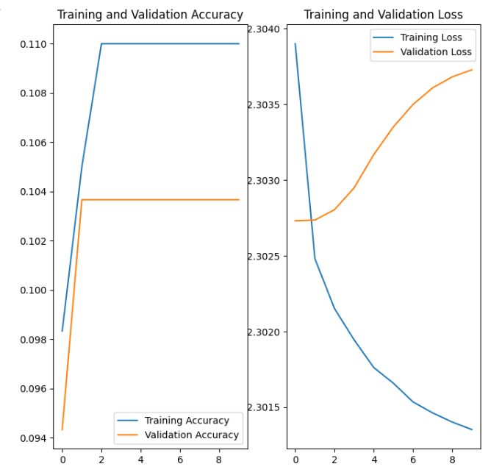
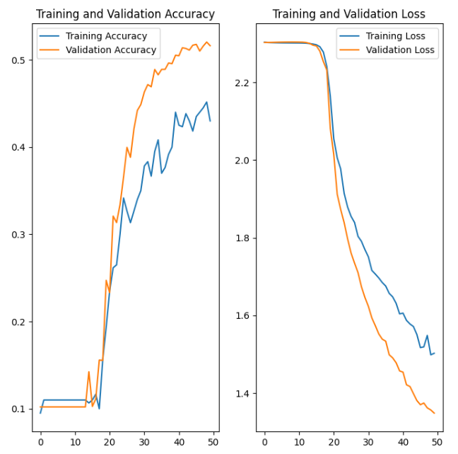
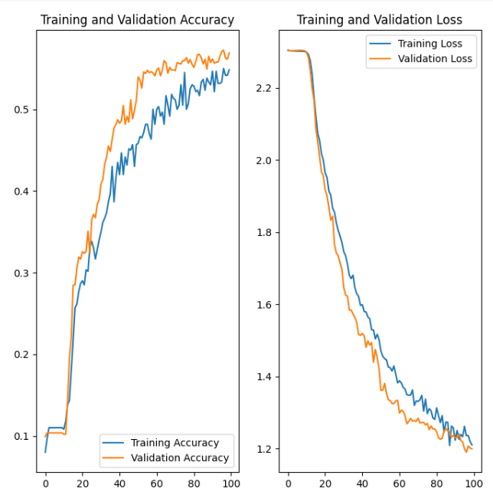
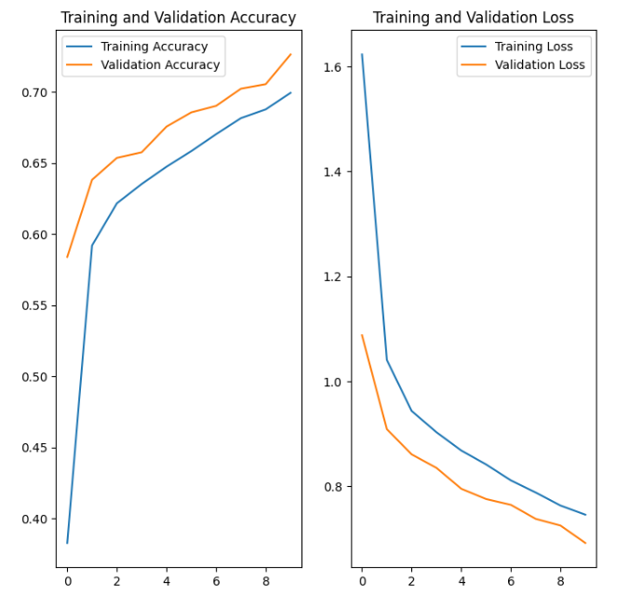
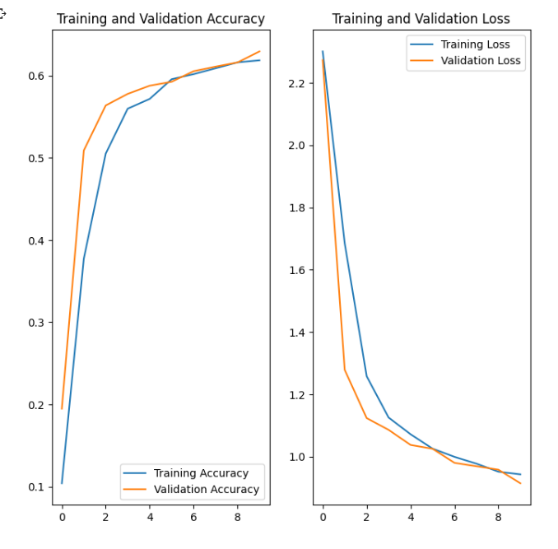
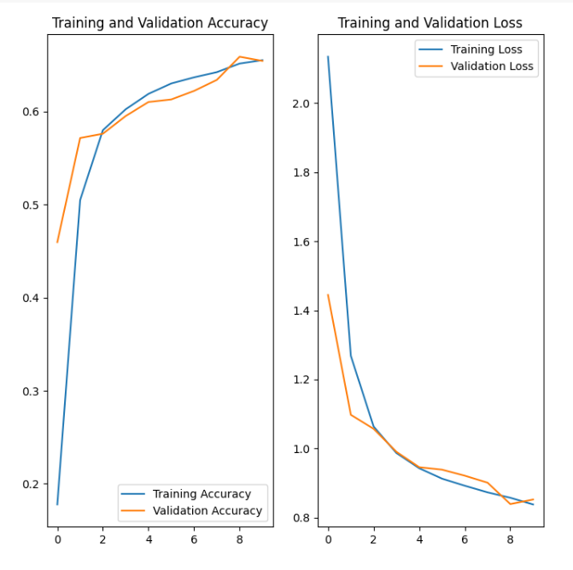
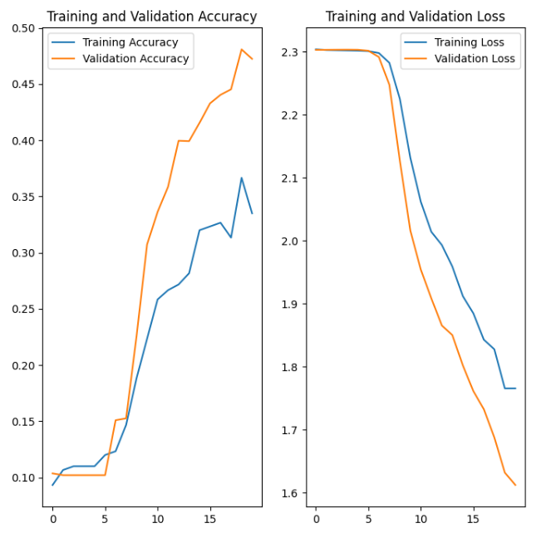
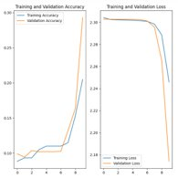
Data Augmentation for images
Training data 40%
Training data 20%
Training data 10%
Training data 1%
Reduced
Try the rest
-file:
augmentation_part_fill.ipynb
Augmented
50 epochs
100 epochs
[3], [4], [5], [6]

Slide 9
Data Augmentation for Timeseries
Data Augmentation for Timeseries
No standard procedure
No premade functions available in Keras
No generalization possible since datasets are different
Extending the dataset through random-based transformations
Jittering
Slicing
Scaling
…
[2]

Slide 10
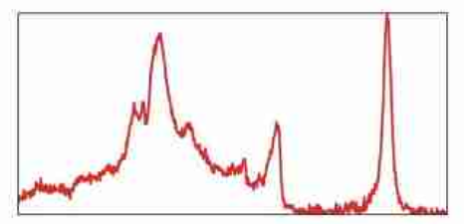
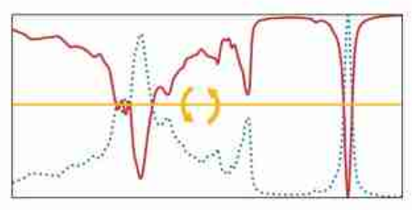
Magnitude Domain Transformations
Data Augmentation for Timeseries
Jittering (Adding noise)
+ good for sensor data
+ helps against time series drift
- suitable only for noisy data
Rotation / Flipping
- only useful in special cases
- mostly not usable with classification problems
[2]

Slide 11
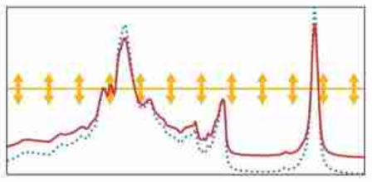
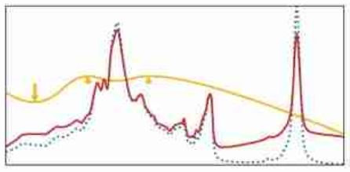
Magnitude Domain Transformations
Data Augmentation for Timeseries
Scaling
+ changes the input levels
- often only useful in combination with other methods
Magnitude warping
+ sections of the data are amplified differently
- requires the real data pattern is close to the amplification pattern
[2]

Slide 12
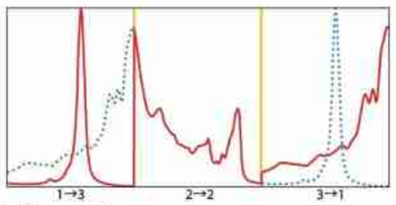
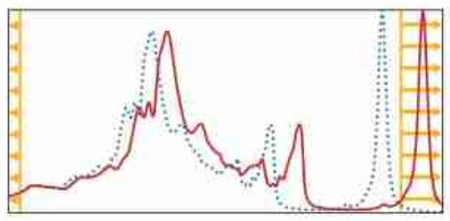
Time Domain Transformations
Data Augmentation for Timeseries
Permutation
+ new pattern by rearranging segments
- for some processes flows not suitable
Slicing
+/- boundary values are removed
[2]

Slide 13
Example
Data Augmentation for Timeseries
Ilias
↓
WPF DLML Sommersemester 2023
↓
Gruppe SoSe2023
↓
Data Augmentation
↓
Data_augmentation_for_time_series.ipynb

Slide 14
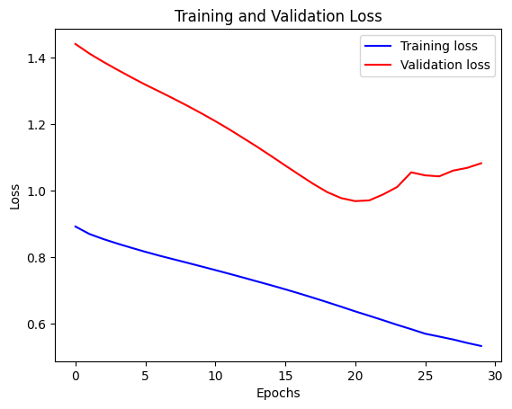
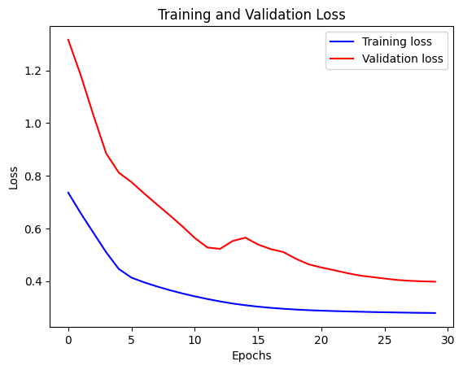
Results
Data Augmentation for Timeseries
overfitting

Slide 15
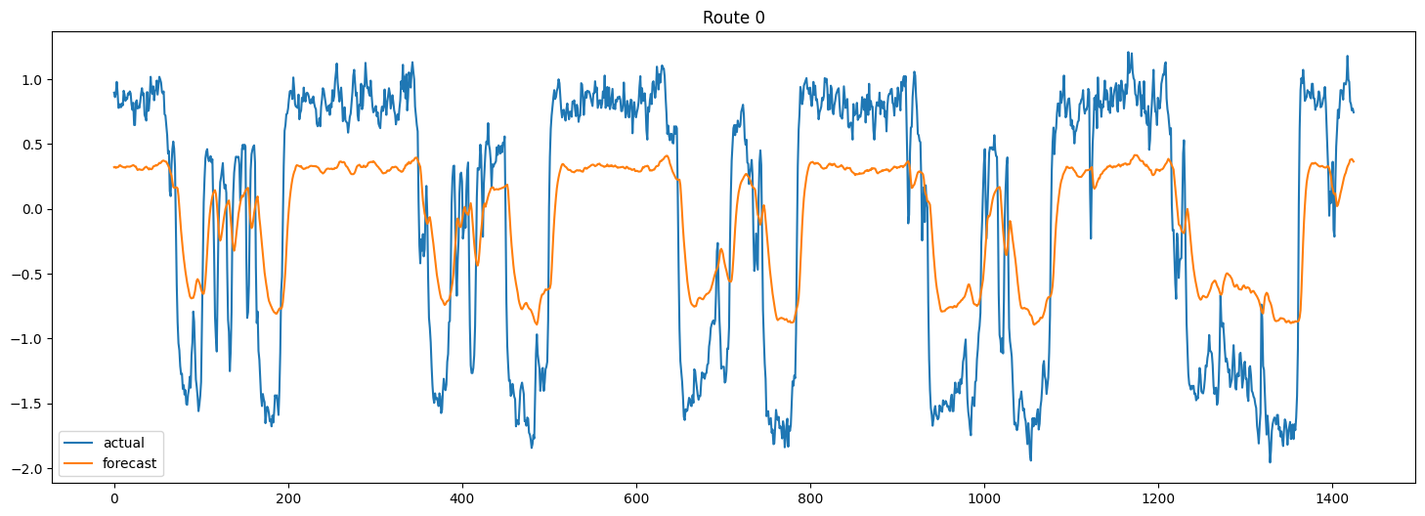
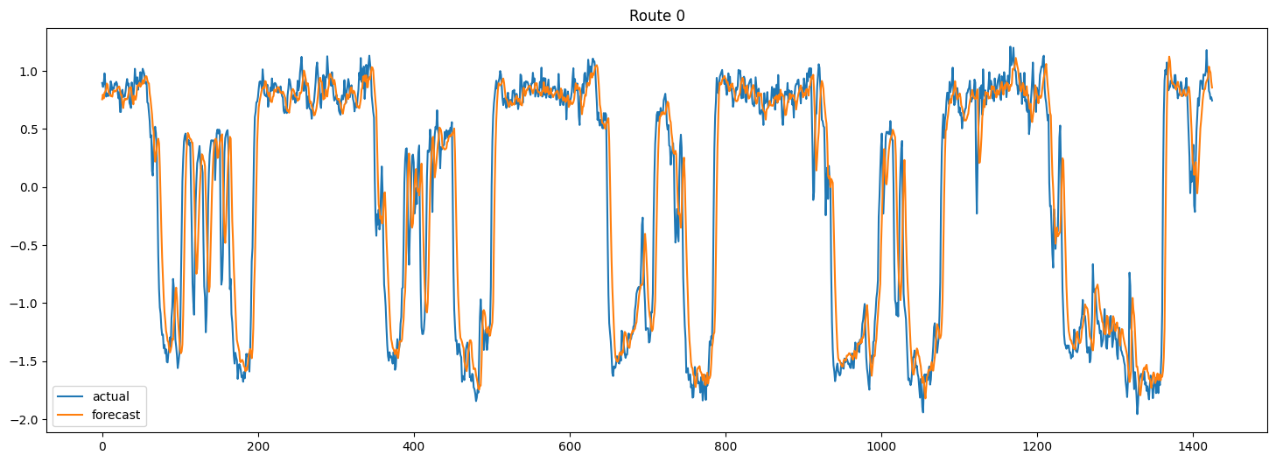
Results
Data Augmentation for Timeseries
Original
With data augmentation

Slide 16
Conclusion
Increasing the accuracy
Reducing overfitting
Not every data augmentation method is suitable for every data
Incorrectly selected methods can degrade model accuracy

Slide 17

Thank you for your attention If you have any questions, please let us know.

Slide 18
Sources
[1] | C. Sun, A. Shrivastava, S. Singh, and A. Gupta, “Revisiting Unreasonable Effectiveness of Data in Deep Learning Era,” International Conference on Computer Vision, pp. 843–852, 2017, doi: 10.1109/ICCV.2017.97.
[2] | B. K. Iwana and S. Uchida, “An empirical survey of data augmentation for time series classification with neural networks,” PloS one, vol. 16, no. 7, 2021, doi: 10.1371/journal.pone.0254841.
[3] | TensorFlow Datasets. "Fashion MNIST." TensorFlow Datasets Catalog. [Online]. Available: https://www.tensorflow.org/datasets/catalog/fashion_mnist?hl=en. [Accessed: June 16, 2023].
[4] | TensorFlow. "Keras: Basic classification." TensorFlow Tutorials. [Online]. Available: https://www.tensorflow.org/tutorials/keras/classification?hl=ko. [Accessed: June 18, 2023].
[5] | "TensorFlow: Data augmentation" [Online]. Available: https://www.tensorflow.org/tutorials/images/data_augmentation?hl=ko#%EB%AA%A8%EB%8D%B8_%ED%9B%88%EB%A0%A8%ED%95%98%EA%B8%B0. [Accessed: June 18, 2023].
[6] | Gholamy, A., Kreinovich, V., & Kosheleva, O. (2018). Why 70/30 or 80/20 relation between training and testing sets: A pedagogical explanation.

